Slide 1
BATTLE OF NEIGHBORHOODS IN LONDON, UK
Anel Mukasheva
May 2020

Slide 2
PROBLEM EXAMINED
NEW RESTAURANT IN LONDON
A person aims to open a new medium-size casual-class Asian cuisine restaurant in London, however, he does not know where exactly. This study will examine 32 London’s boroughs with respect to demographic indexes such as borough population and average income. Another aspect lying under the scope of the study is evaluation of the level of competition in different boroughs in the sphere of restaurant business.
TARGET AUDIENCE
Businessmen, restaurateurs, investors and other people interested in the systematic approach to the choice of location.

Slide 3
DATA USED
“Borough data” – provides information on population estimates of each borough
"HMRC Survey of Personal Incomes" – provides information on average income in each boroughBut remember not to overload your slides with content
Foursquare.com – provides information about venues located in the particular geographical location

Slide 4
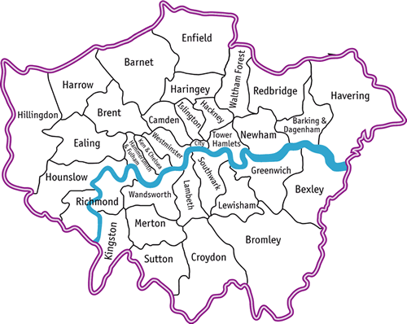
LONDON BOROUGHS
Since the aim is to start casual-class medium-size restaurant, we are more interested in high foot traffic and thus, higher value of borough population has higher priority rather than higher average income per borough.

Slide 5
INVESTIGATION ALGORITHM
It was decided to implement multi-stage selection process
1. Population
2. Average Income
3. Number of Competitors
Top 15 most populated boroughs were selected
Top 5 boroughs with the highest index of average income were selected among top 15 most populated ones
Borough with the lowest number of Asian restaurants in it was chosen as the best location for starting new restaurant

Slide 6
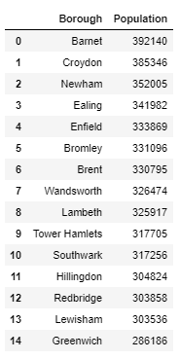
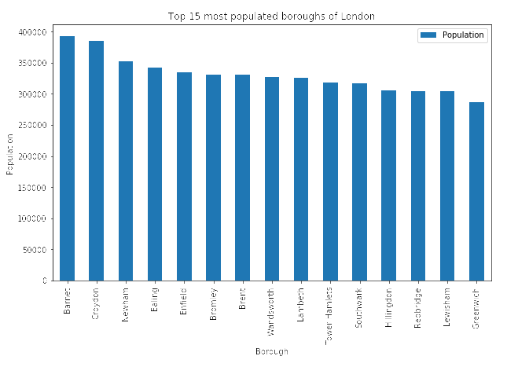
SELECTION BY POPULATION RESULTS
Top 15 most populated boroughs among all 32 located in London

Slide 7
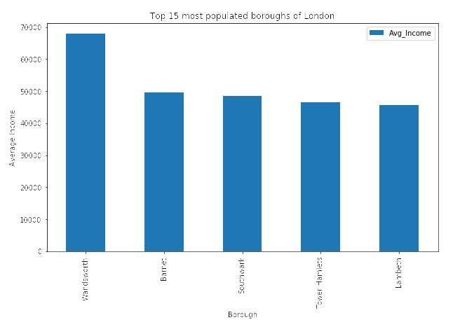
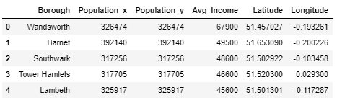
SELECTION BY AVERAGE INCOME RESULTS
Top 5 boroughs with the highest population – average income index

Slide 8
SELECTION BY NUMBER OF COMPETITORS
All information regarding competitors was obtained using Foursquare website
Borough | Number of Asian Restaurants
Southwark | 7
Lambeth | 4
Wandsworth | 2
Barnet | 1
Since Barnet borough has the lowest number of Asian restaurants it is considered to be the best location for opening new Asian restaurants

